Slide 1

AD_HOC INSIGHTS
Consumer Goods

Slide 2
Project analysis slide 2
Objectives
Atliq Hardware, a leading computer hardware manufacturer in India, also maintains a strong presence in several other countries.
Management recognized that, without deeper insights, they are unable to make prompt, well-informed, and data-driven decisions
They are planning to expand the data analytics team by bringing in junior data analysts to enhance data-driven decision-making.
Data Analytics Director Tony Sharma intends to evaluate candidates through an SQL challenge that measures both their technical capabilities and soft skills.
The company seeks insights for 10 ad-hoc requests.

Slide 3
Project analysis slide 2
Company Details
Atliq Hardware is a computer hardware and accessory manufacturer
FISCAL YEAR
SEPTEMBER 2019 - AUGUST 2020
FY 2020
SEPTEMBER 2020 - AUGUST 2021
FY 2021
Category
Segment
Division

Slide 4
Company Products Details
P & A
PC
N & S
Peripherals
Accessories
Notebook
Desktop
Storage
Networking
Internal HDD
Keyboard
Personal Laptop
Business Laptop
External Solid-State Drives
Wi fi extender
Graphic Card
Batteries
Business Laptop
Personal Desktop
USB Flash Drives
Processors
Mouse
Gaming Laptop
MotherBoard

Slide 5
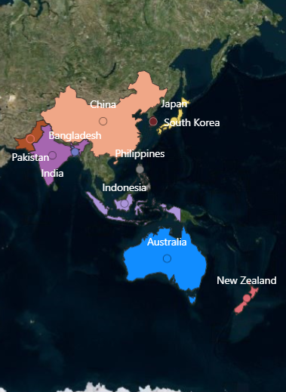
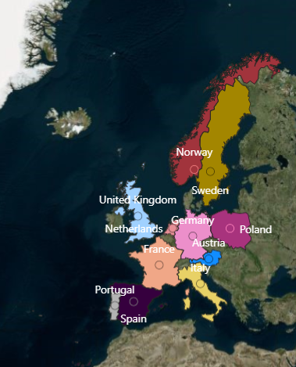
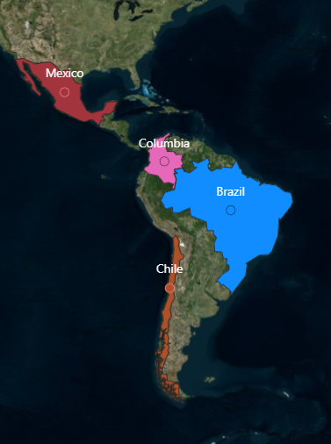
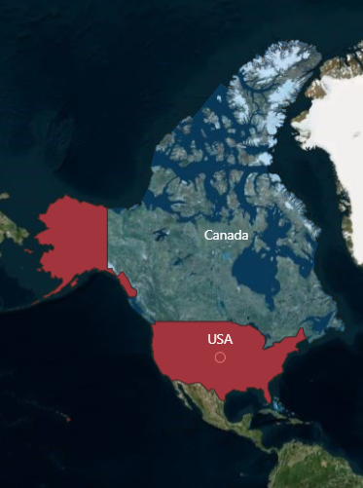
Company’s Market
APAC
EU
LATAM
NA

Slide 6
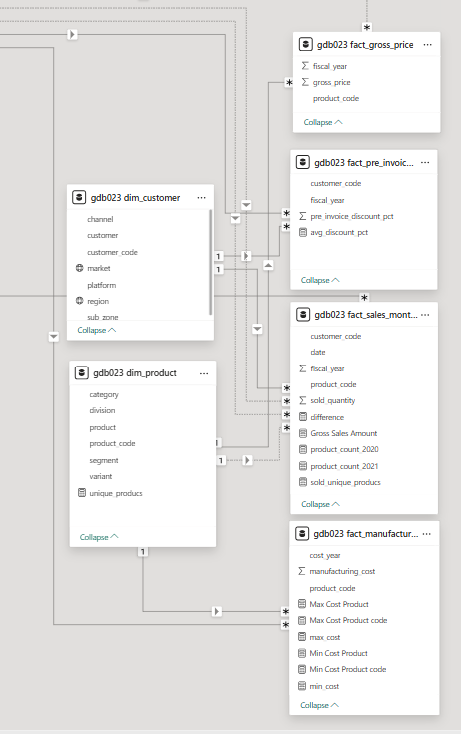
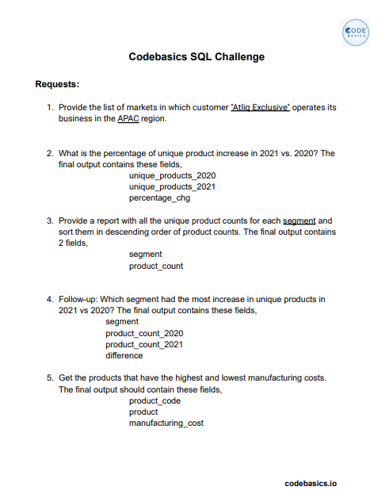
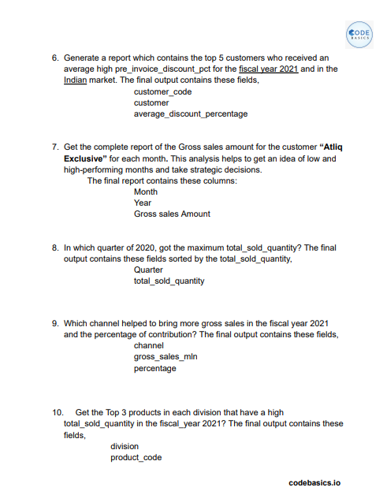


Data, Request & Tool

Slide 7
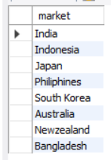
Project analysis slide 2
1. Provide the list of markets in which customer "Atliq Exclusive" operates its business in the APAC region.

Slide 8
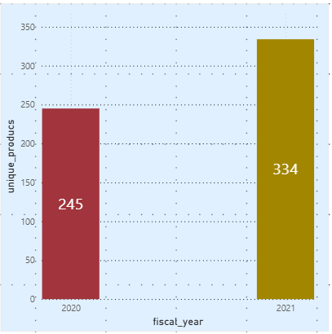

Project analysis slide 2
2. What is the percentage of unique product increase in 2021 vs. 2020? The final output contains these fields, unique_products_2020
unique_products_2021
percentage_chg
Insights :
Demand and production both increased
Unique Product
2020
Unique Product
2021

Slide 9
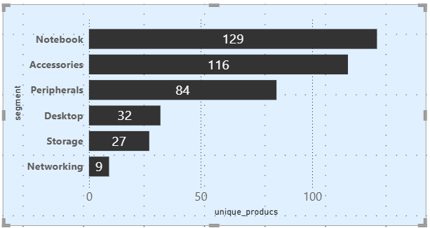
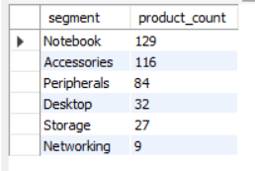
Project analysis slide 2
3. Provide a report with all the unique product counts for each segment and sort them in descending order of product counts. The final output contains 2 fields,
segment
product_count
Insights :
Segments: notebooks, accessories, and peripherals are showing significant manufacturing growth as compared to desktops, storage, and networking.
Notebooks, accessories, and peripherals constitute 83% of the total manufactured product.

Slide 10
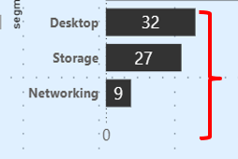
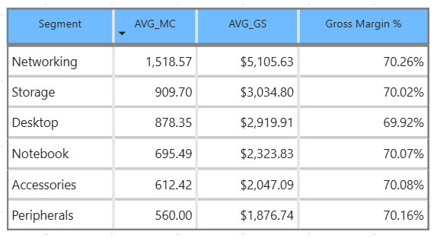
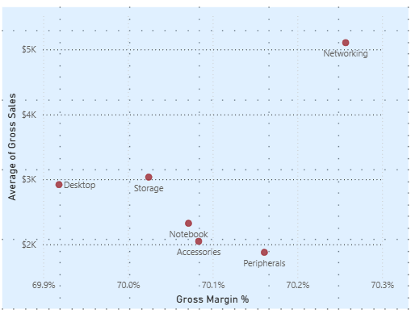
WIFI extender
USB Flash
Drives External
Solid State Drives
Personal Desktop
Business Laptop
AVG MC: Average Manufacturing Cost
AVG GS: Average Gross Sales

Slide 11
Suggestions
Increase price where the market can bear it : Even a small increase can flip negative margins to positive.
Bundle products: Pair high-cost items with high-margin items to improve overall profitability.
Promotions carefully: Avoid discounting products that already have very thin or negative margins.
Negotiate supplier costs or find cheaper manufacturing alternatives.
Optimize product design to reduce manufacturing cost.
Reduce waste in production.
Shift marketing efforts toward products or segments where Gross margin % is healthy.
Consider discontinuing low-margin products if they don’t drive strategic value.
Cross-selling and upselling: Sell complementary products.
Promotions on high-margin items: Encourage buying profitable items.
Targeted marketing: Focus on customer segments more likely to buy higher-margin products.

Slide 12
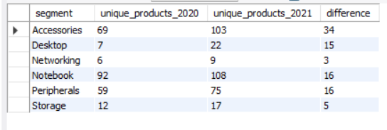
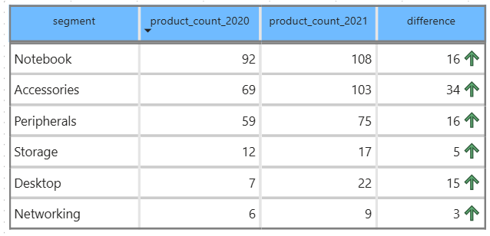
Project analysis slide 2
4. Fellow-up: Which segment had the most increase in unique products in 2021 vs 2020? The final output contains these fields,
segment product_count_2020
product_count_2021
difference
Insights:
Accessories had the largest increase in production. Storage and networking are experiencing slower production growth than other segments.

Slide 13

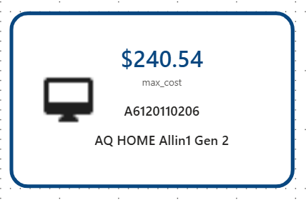
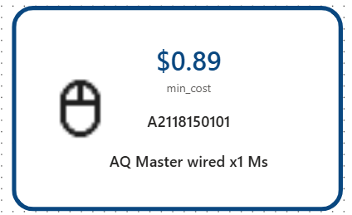
Project analysis slide 2
5. Get the products that have the highest and lowest manufacturing costs. The final output should contain these fields, product code
product
manufacturing cost
Product that having a Highest manufacturing cost
Product that having a Highest manufacturing cost
Insights:
Mouse: AQ Master wired x1 Ms (Variant:Standard1) has the lowest manufacturing cost.
Personal Desktop: AQ Home Allin1 Gen2 (Variant:Plus3) has the highest manufacturing cost

Slide 14
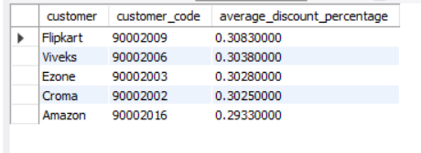
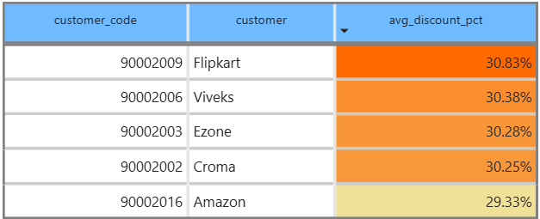
Project analysis slide 2
6. Generate a report which contains the top 5 customers who received an average high pre_invoice_discount_pct for the fiscal year 2021 and in the Indian market. The final output contains these fields,
customer_code
customer
average_discount_percentage
Insights
The largest average pre-invoice discount was given to Flipkart.
The least average pre-invoice discount was given to Amazon.

Slide 15
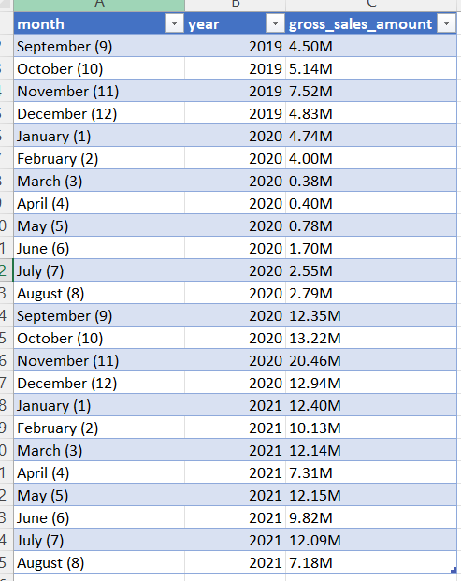
Project analysis slide 2
7. Get the complete report of the Gross sales amount for the customer “Atliq Exclusive” for each month. This analysis helps to get an idea of low and high-performing months and take strategic decisions. The final report contains these columns:
Month
Year
Gross sales Amount
FY 2020
79.5M
Insights
The lowest Gross sales total for both fiscal years is in March(2020).
The highest Gross sales total for both fiscal years is in November (2020)
73.8%ofthe total Gross sales figure is in FY2021.
FY 2021
224.4M

Slide 16
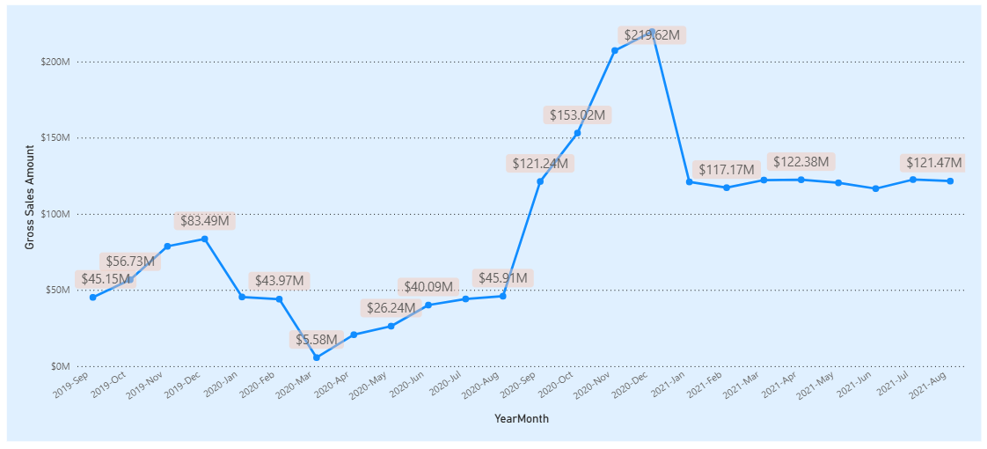
Project analysis slide 2
FY 2020 – December
Highest Gross Sales amount
FY 2020 - March
Lowest Gross Sales amount

Slide 17
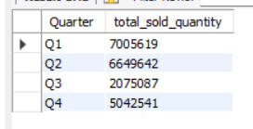
Project analysis slide 2
In which quarter of 2020, got the maximum total_sold_quantity ?
The final output contains these fields sorted by the
total_sold_quantity
Quarter total_sold_quantity
Insights:
Quarter 1 of FY2020 saw the most units sold overall, while Quarter3 had the fewest.
The highest and lowest overall sold quantity is in December and March.
Quarter1 accounts for approximately 34% of the total sold quantity for FY2020.
Q1 - Quarter 1
Q2 – Quarter 2
Q3 – Quarter 3
Q4 – Quarter 4

Slide 18
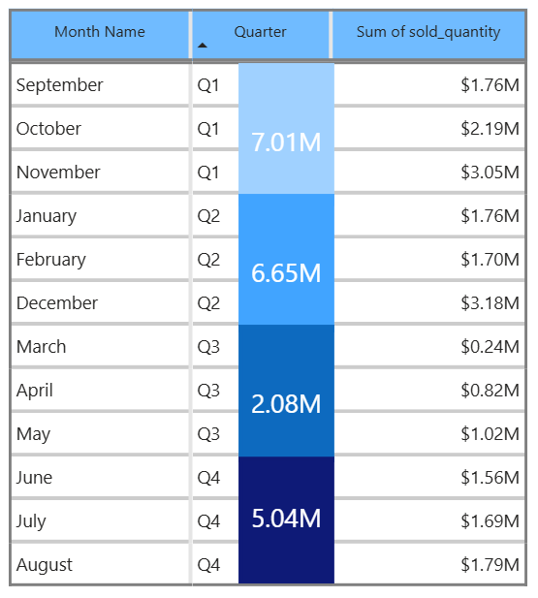
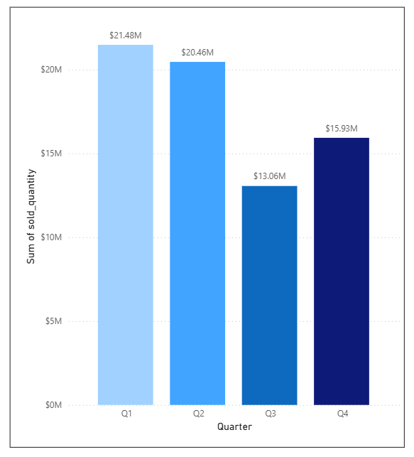
Total sold quantity in FY 2020 by Quarter

Slide 19
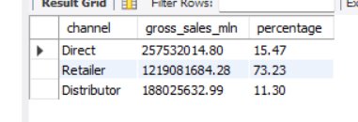
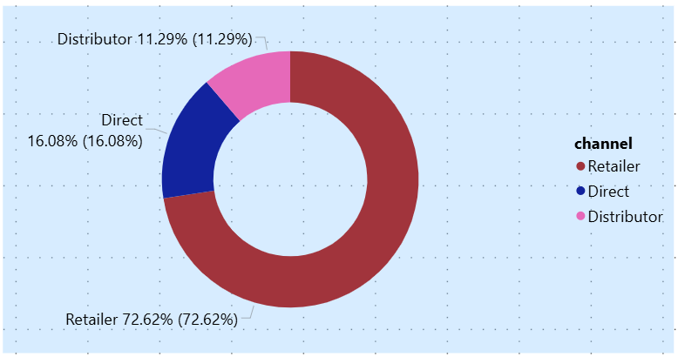
Project analysis slide 2
9. Which channel helped to bring more gross sales in the fiscal year 2021 and the percentage of contribution? The final output contains these fields,
channel
gross_sales_mln
percentage
Insights :
Channel: "Retailer " helped bring maximum sales to the company with 73.22% as the contribution percentage.
Channel: "Distributor " makes the least contribution at a percentage of11.31%

Slide 20
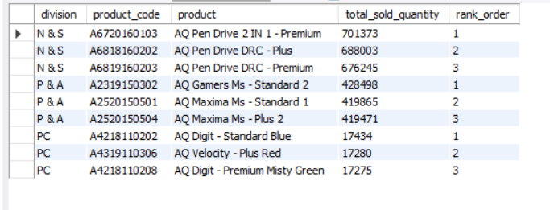
Project analysis slide 2
10. Get the Top 3 products in each division that have a high total_sold_quantity in the fiscal_year 2021? The final output contains these fields
division product_
product
total_sold_quantity
rank_order
Insights :
Every division has a product with different variants that appears twice in the top three products by division list

Slide 21
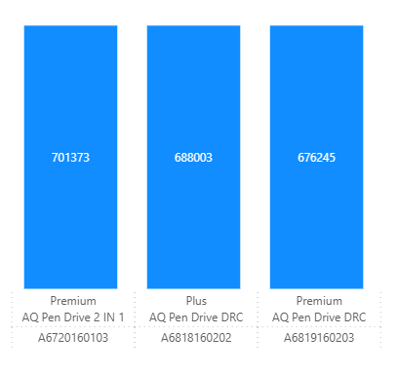
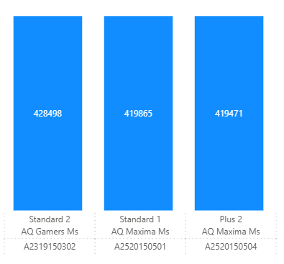
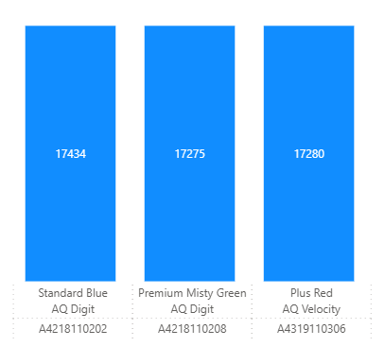
Division
PC
Division
N&S
Division
P&A

Slide 22
Thank You

